Slide 1
Welcome!!
Coach Hill, Coach Mitchell, and Ms. Baron
Room 1212
Algebra 2

Slide 2
Today’s Schedule:
Class Rules
Procedures
Syllabus
Let’s Begin!

Slide 4
Classroom Rules
Be Prepared
Be Respectful
Be on Time
Follow Directions First Time Given
Food or Drinks

Slide 5
Procedures
Entering the classroom
Leaving the classroom
Pass Use
Questions- Just Ask! ☺

Slide 6
Procedures
Seating Arrangement
Noise Level
Teacher’s Desk
Partner Work
Show all Work
No Grooming
No Distracting Other’s Education

Slide 7
Syllabus

Slide 8
BLOG!!

Slide 9
Let’s Begin!!! ☺

Slide 10
Algebra II
What is the terminology we use to analyze numbers and functions?

Slide 11
Imaginary Numbers
Real Numbers

Slide 12
Imaginary Numbers
Real Numbers
Rational Numbers
Irrational Numbers
Integers
Whole Numbers
Counting/Natural Numbers
Complex Numbers

Slide 13
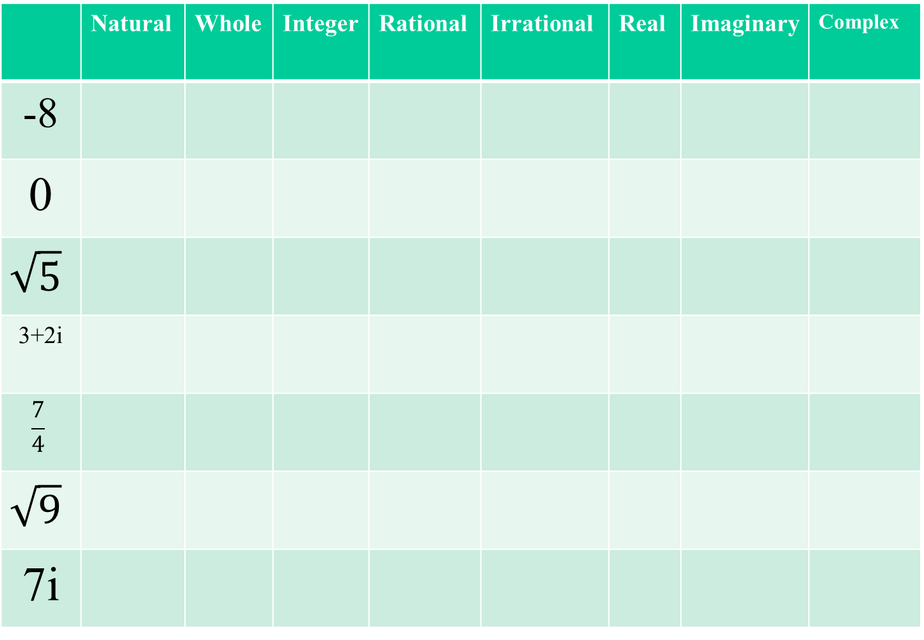
Into which groups does each number go?
 | Natural | Whole | Integer | Rational | Irrational | Real | Imaginary | Complex
-8
0
$$\sqrt{5}$$
3+2i
$$\frac{7}{4}$$
$$\sqrt{9}$$
7i

Slide 14
Into which groups does each number go?
 | Natural | Whole | Integer | Rational | Irrational | Real | Imaginary | Complex
-8
0
$$\sqrt{5}$$
3+2i
$$\frac{7}{4}$$
$$\sqrt{9}$$
7i

Slide 15
Homework:
Number systems

