Slide 1
Homework Check

Slide 2
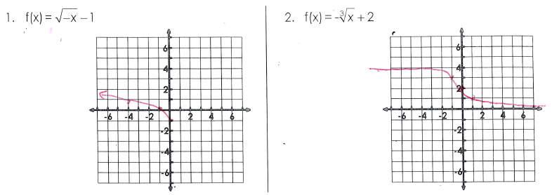
Homework Check

Slide 3
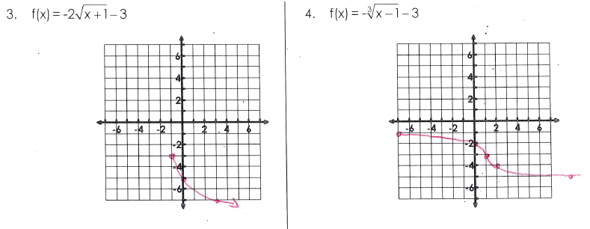
Homework Check

Slide 4
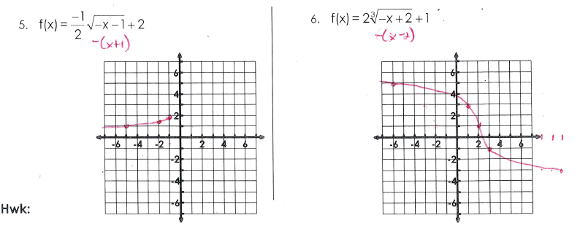
Homework Check

Slide 5
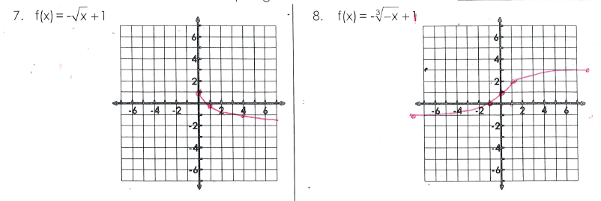
Homework Check

Slide 6
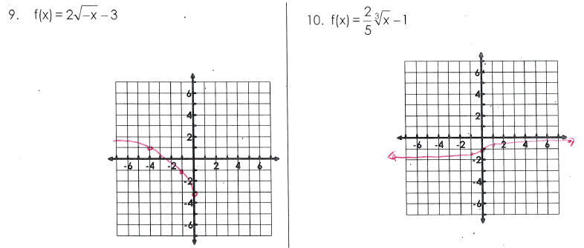
Homework Check

Slide 7
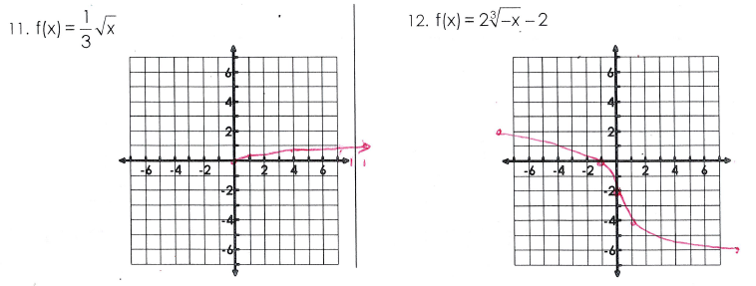
Homework Check

Slide 8
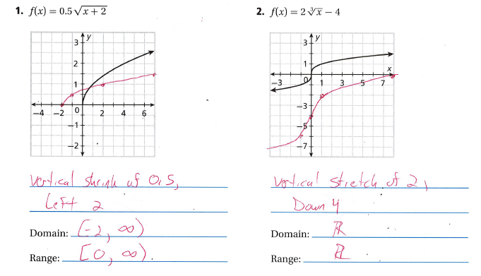
Homework Check

Slide 9
Homework Check

Slide 10
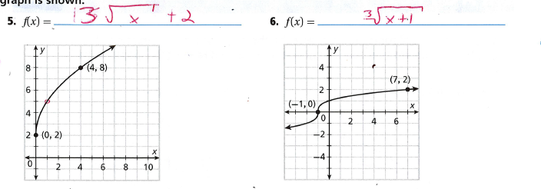
Homework Check

Slide 11
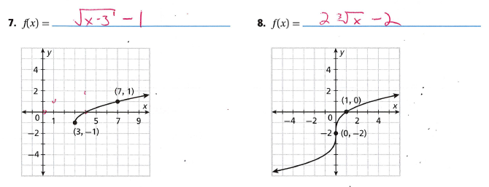
Homework Check

Slide 12
Homework Check

Slide 13
Characteristics of Radical Functions

Slide 14
